Slide 1
A Linear Space Algorithm for Computing a Longest Common Increasing Subsequence
Yoshifumi Sakai
Information Processing Letters 99 (2006), pp. 203–207
Presenter : Hsiang-Yi Weng
Date : September 10, 2008

Slide 2
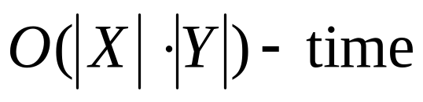
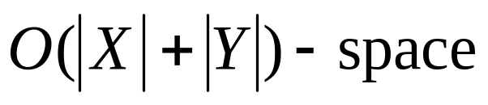
Abstract(1/2)
Let X and Y be sequences of integers. A common
increasing subsequence of X and Y is an increasing
subsequence common to X and Y . In this note, we
propose an and
algorithm for finding one of the longest common
increasing subsequences of X and Y , which
improves the space complexity of Yang et al.

Slide 3
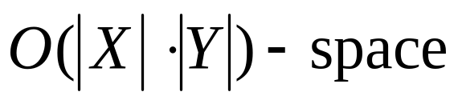
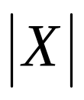

Abstract(2/2)
and
algorithm, where and denote the
lengths of X and Y , respectively.

Slide 4
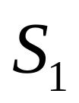
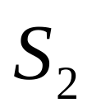
Example
=35274816
=51724863
the LCIS of and is 246

Slide 5
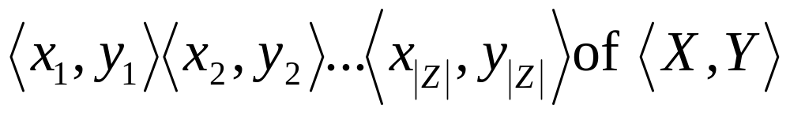
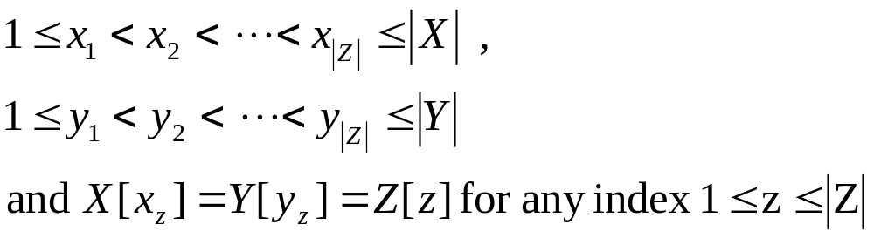
The algorithm
The algorithm proposed in this note is based on Hirschberg’s divide-and-conquer method of solving the LCS problem in linear space
representing Z

Slide 6
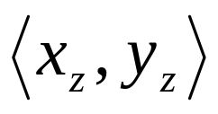
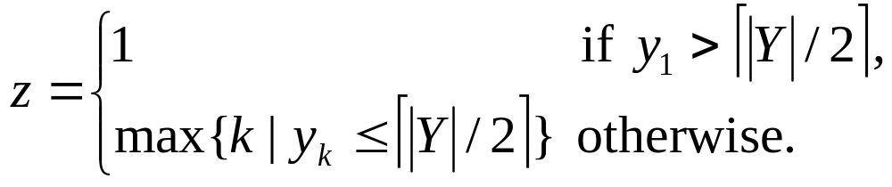
The algorithm
Let the center of an index sequence
representing Z
be such that

Slide 7
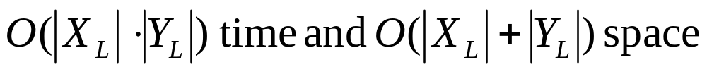
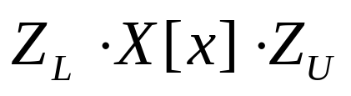
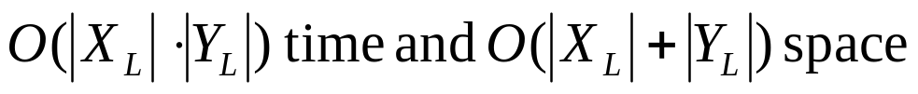
Lemma 1.
O(|X| · |Y|) time and O(|X| + |Y|) space.

Slide 8
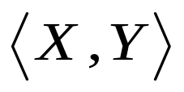
Lemma 1.
Assume that, for any integer sequences, X and Y , and any integers, l and u, the center of an index sequence of representing one of the longest (X,Y, l, u) - CISs can be computed in O(|X| · |Y|) time and O(|X| + |Y|) space. The, for any integer sequences, X and Y , and any integers, l and u, one of the longest (X,Y, l, u) - CISs can be computed in O(|X|·|Y|) time and O(|X| + |Y|) space.

Slide 9
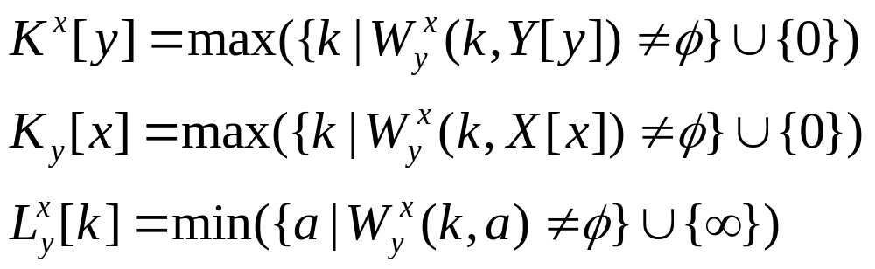

Slide 10
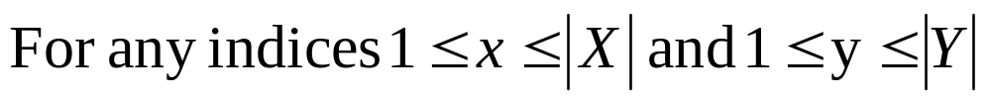
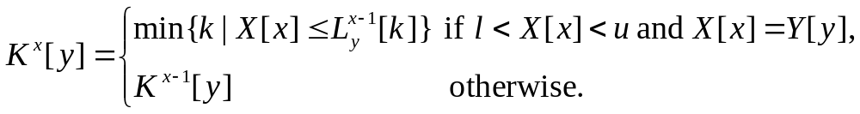
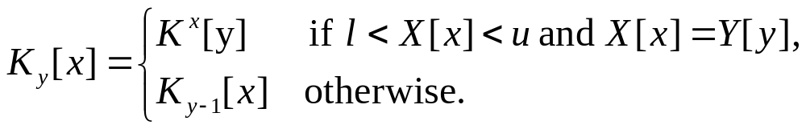
Lemma 2.
X=35274816
Y=51724863
the LCIS of and is 246
and

Slide 11
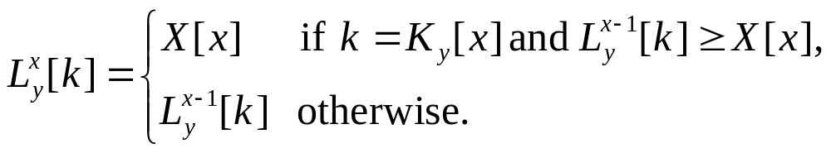
Lemma 3.
X=35274816
Y=51724863
the LCIS of and is 246

Slide 12
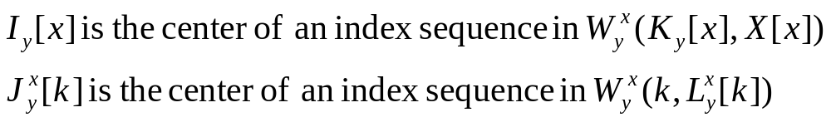
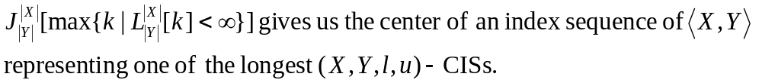

Slide 13
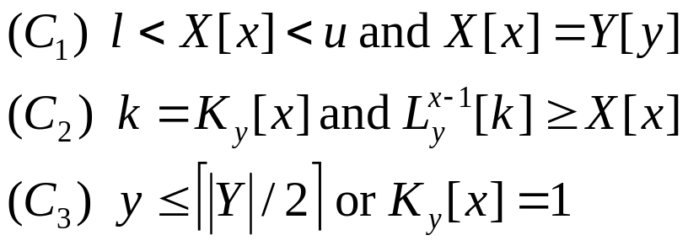
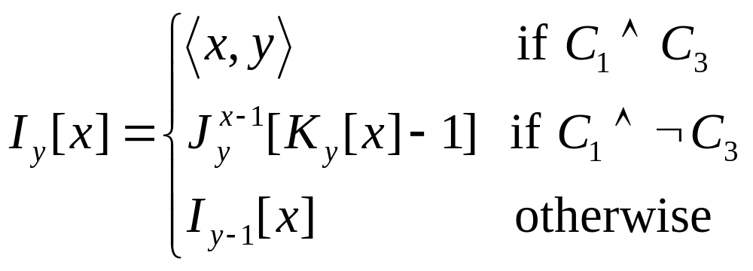
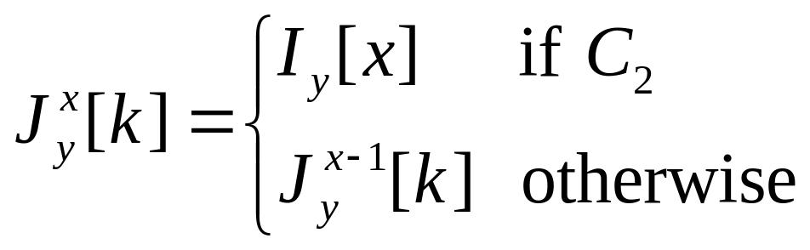
and

Slide 14
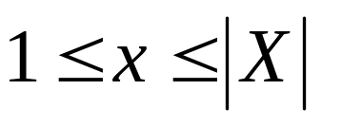
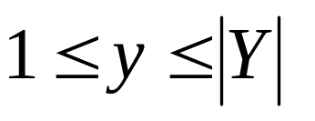
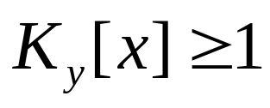
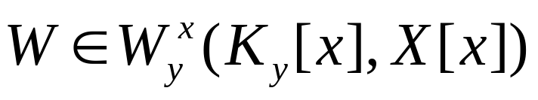
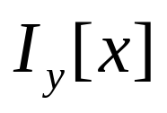
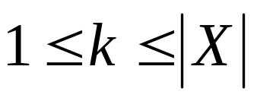
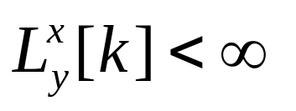
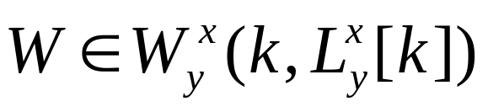
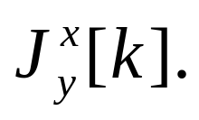
Lemma 4.
X=35274816
Y=51724863
the LCIS of and is 246
For any indices and ,
if , then there exists
whose center is , and for any length ,
if , then there exists
Whose center is

Slide 15
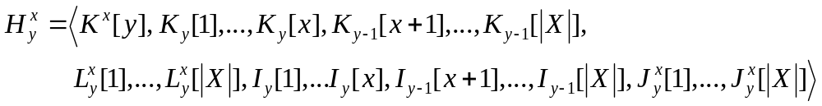
Lemma 5.
X=4 1 3
Y=3 1 7 2 4 3, l=0 and u=5

Slide 16
Lemma 5.
X=4 1 3
Y=3 1 7 2 4 3, l=0 and u=5

Slide 17
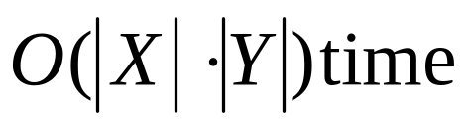
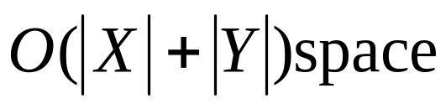
Lemma 5.
For any integer sequence, X and Y, and any
integers, l and u, the center of an index sequence
of <X, Y> representing one of the longest
(X, Y, l, u) - CISs can be computed in
and

Slide 18
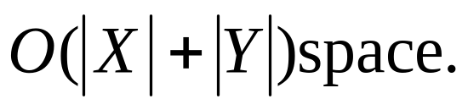
Theorem 1.
For any integer sequences, X and Y, and any
integers, l and u, one of the longest (X, Y, l, u) – CISs
can be computed in and

